Slide 1
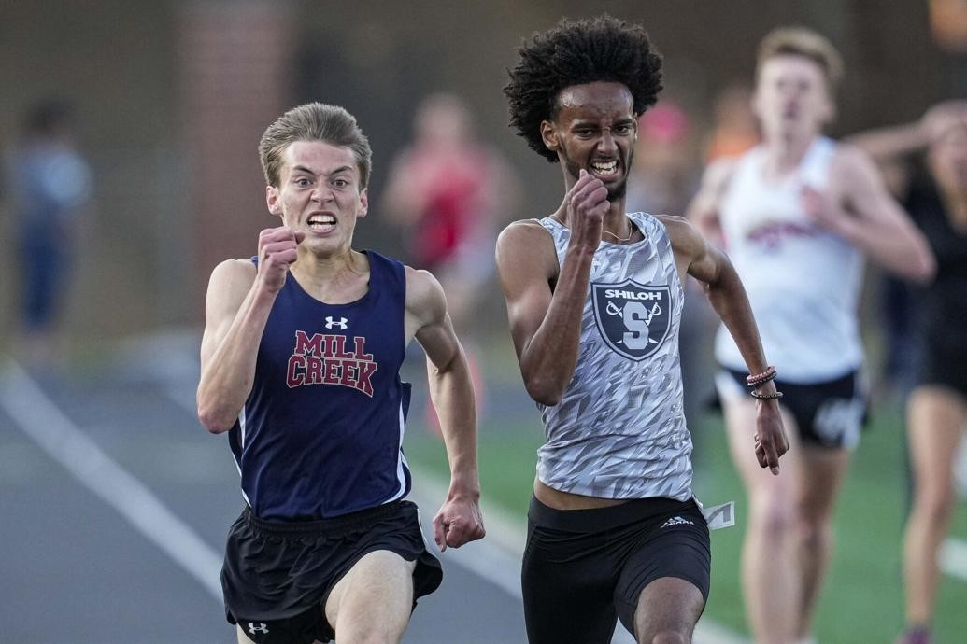
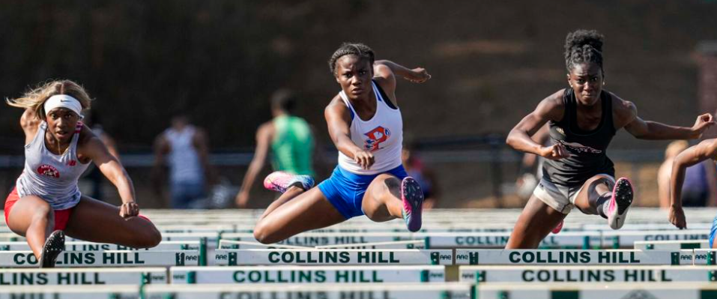
Welcome to the 2022 Gwinnett County
All-County Track & Field Banquet!

Slide 2
Gwinnett County Track & Field Coaches
WWW.GWINNETTXCTF.COM
GDP ARTICLES / CURRENT SEASON UPDATES
HALLS OF FAME FOR XC & TRACK & FIELD
XC & TRACK & FIELD RECORDS—COUNTY/REGION/STATE/ETC.
WWW.GATFXCCA.ORG
STATE ALL-TIME LISTS/NATIONAL/OLYMPIC/WORLD
HALL OF FAME

Slide 3
ALL-COUNTY STANDARDS
County Champions—Automatic (including relays)
State Champions—Automatic (including relays)
Elite Standards (Individual Events Only)
Special circumstances determined by the Hall of Fame Committee

Slide 4
GWINNETT GIRLS ALL-TIME UPDATE SUMMARY AFTER 2022
Long Jump 1
Triple Jump 1
High Jump 2
Shot Put 2
Discus 5
Pole Vault 1
100m 1 (new#1)
4x200m 3 (new #2)
400m 2
800m 1
200m 1
20 NEW UPDATES IN 11 EVENTS

Slide 5
GWINNETT BOYS ALL-TIME UPDATE SUMMARY AFTER 2022
Long Jump 1
Triple Jump 1
High Jump 2
4x800m 2 (new #2)
110mH 1
100m 1
4x200m 4 (new #2)
4x100m 1 (new #1)
400m 1
300mH 4
200m 2
3200m 2
4x400m 3
4x1600m 1 (new #3)
DMR 1 (new #4)
SMR 1 (new #8)
28 NEW UPDATES IN 16 EVENTS

Slide 6
GEORGIA ALL-TIME UPDATE SUMMARY (GWINNETT) AFTER 2022
GIRLS
100m #7 Tamiia Fuller, Peachtree Ridge
4x200m #8 Brookwood
BOYS
Long Jump #3 Christian Barker, Shiloh
Mill Creek 4x1600m – 17:42.56 - #4
4x100m #1 Buford

Slide 7
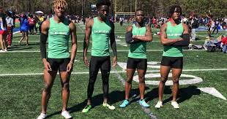
40.05
Victor Venn, K.J. Bolden, Tobi Olawole, Isaiah Bond
Coach Fyrone Davis
#1 in Gwinnett history .88 seconds faster than previous #1
#1 in Georgia history .44 seconds faster than previous #1
#2 in United States currently 39.98 Duncanville (TX) #1
Tied for #8 in United States history Duncanville (TX) currently #5

Slide 8
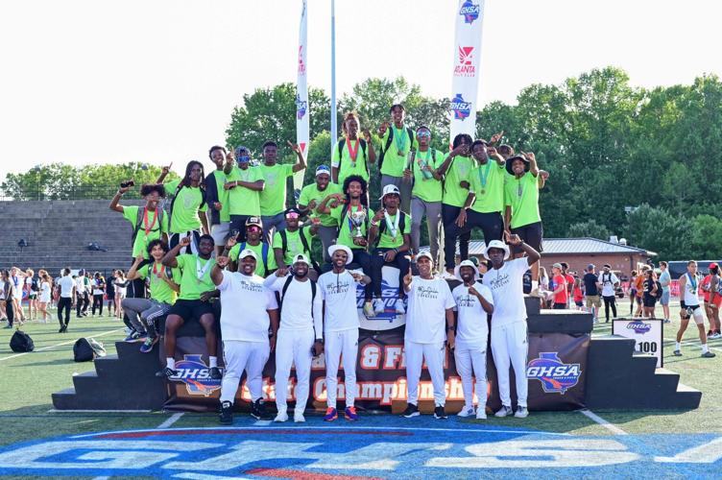
Congratulations to the Shiloh Boys who won the 6A State Championship!

Slide 9
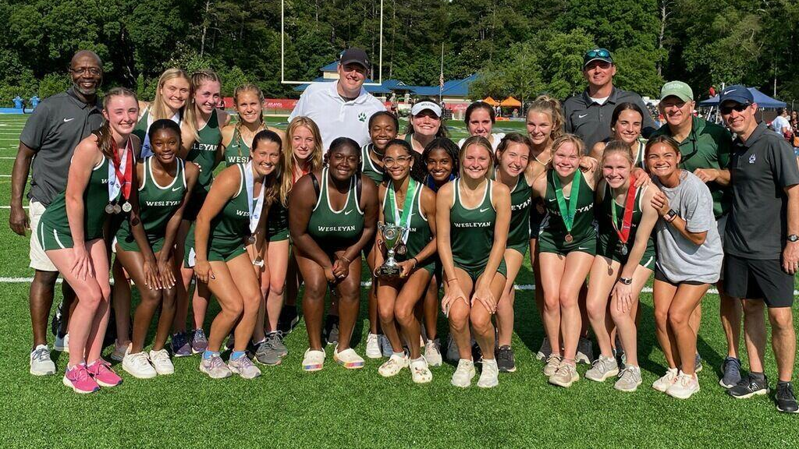
Congratulations to the Wesleyan Girls who were Runners Up in 1A Private!

Slide 10
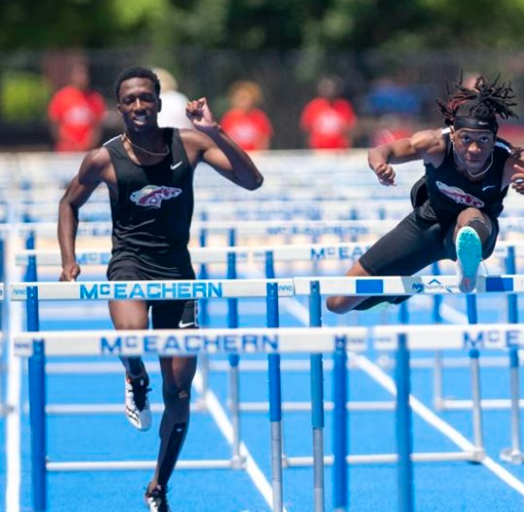
Congratulations to the Brookwood Boys who were Runners up in 7A!

Slide 11
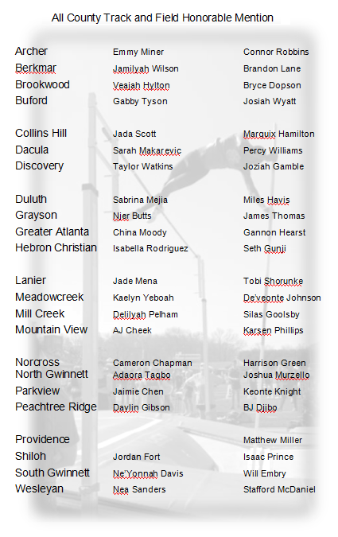
Congratulations to the following athletes for their selection as an Honorable Mention for the 2022 Gwinnett All-County Track & Field Team!

Slide 12
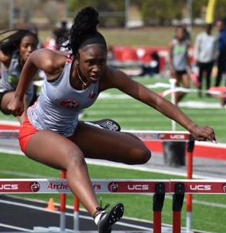
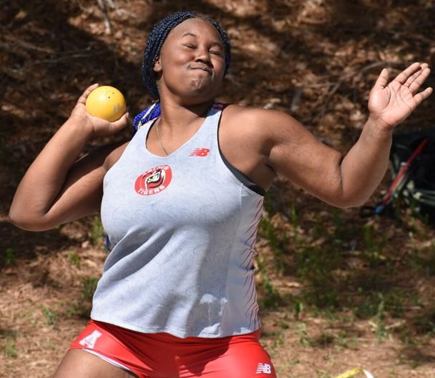
Christianne Akintayo
Camryn King

Slide 13
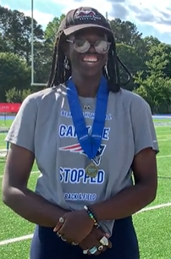
Sha’Nyia Woolery

Slide 14
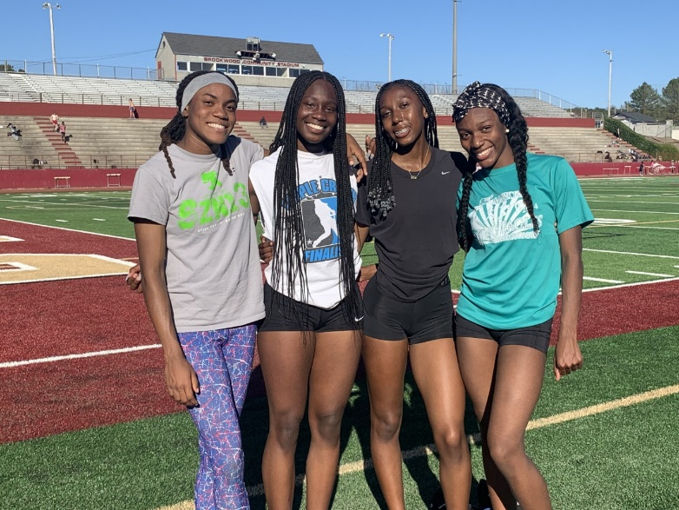
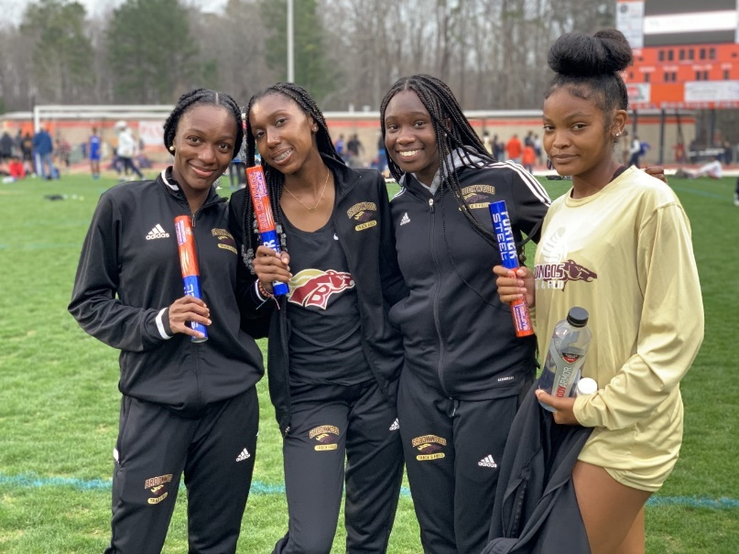
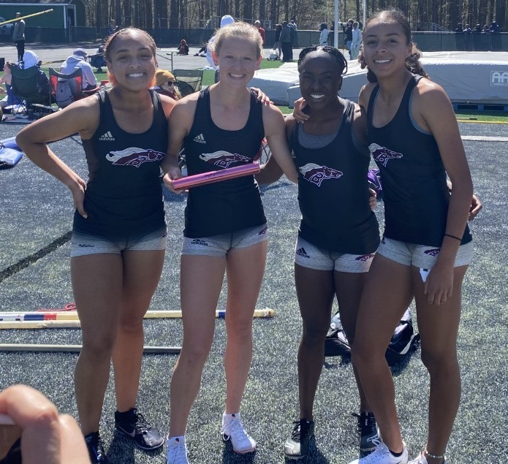
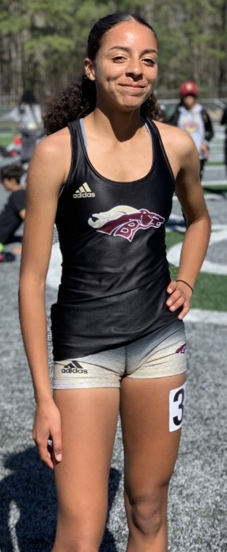
Girls 4x100m
Girls 4x200m
Girls 4x400m
Girls 4x800m
Amaiya Dillard, Chloe Perryman, Elle Bass, Janai Jones, Serena Tate, Madison Campbell, Macy Felton, Allie Wardle, Kayci Jordan, Trinity Thurman

Slide 15
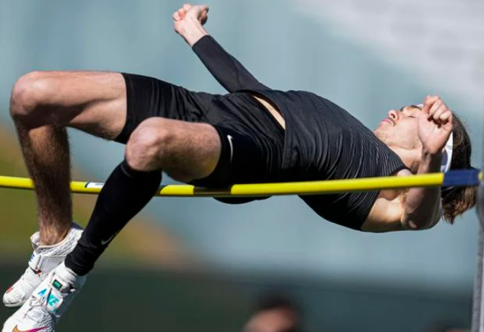
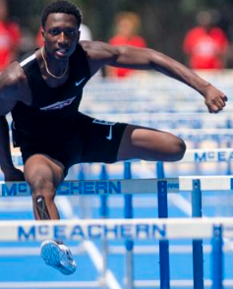
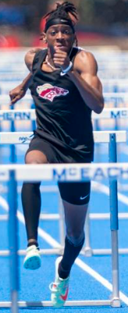
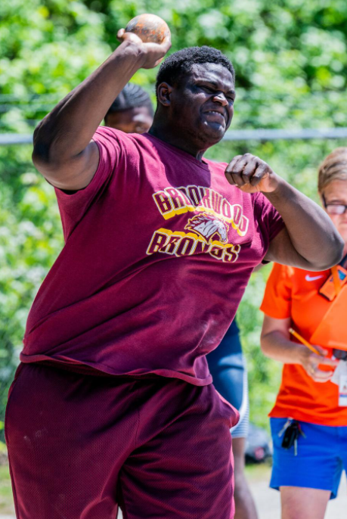
Braden Deal
Langston Jones
Joshua Crum
Makai Williams

Slide 16
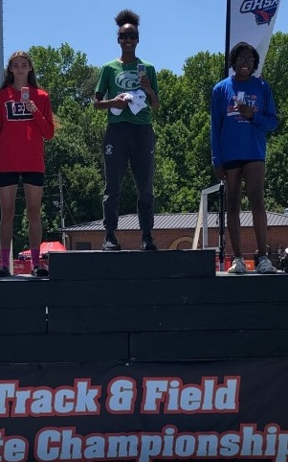
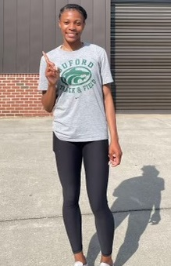
Aiya Webb
Sydney Harris

Slide 17
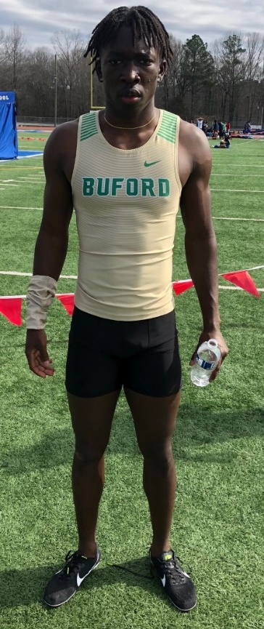
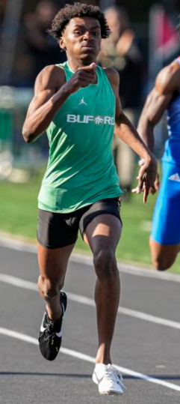
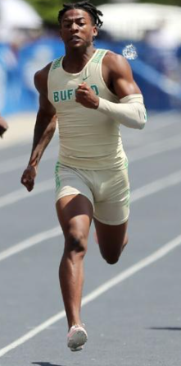
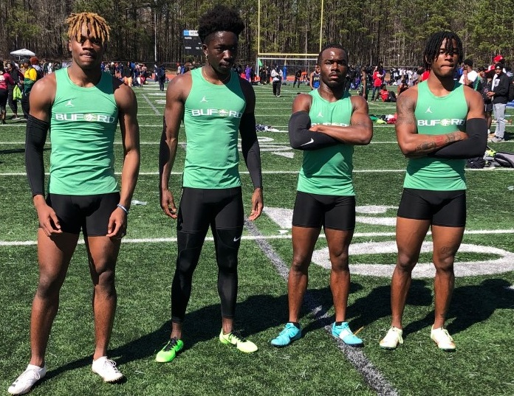
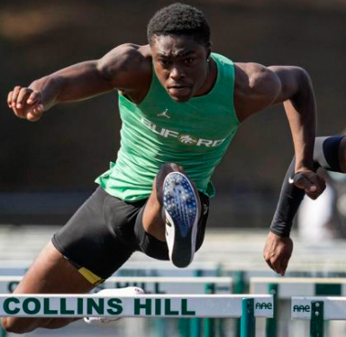
Boys 4x200m
CJ Clinkscales, Victor Penn, Victor Payne, Devin Williams, Isaiah Bond, Tobi Olawole

Slide 18
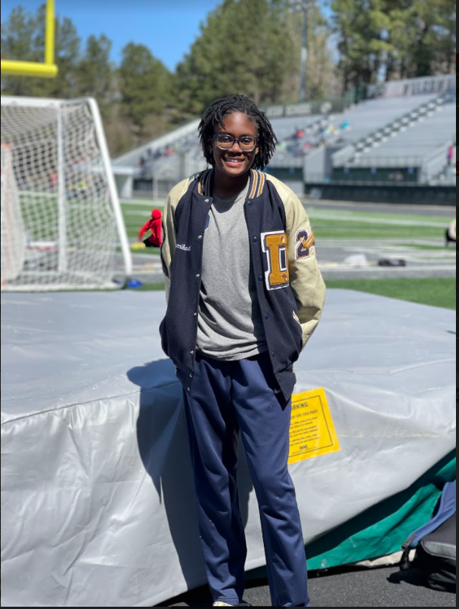
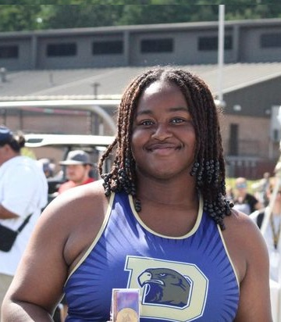
Danah Nembhard
Noelle Igberaese

Slide 19
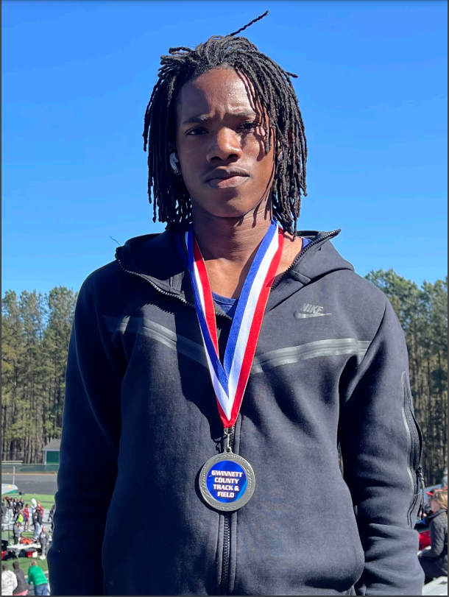
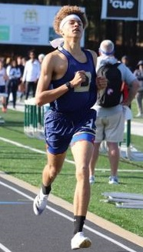
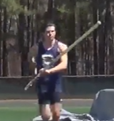
Azwan Nembard-Belcher
Tyler Farris
Chance Jones

Slide 20
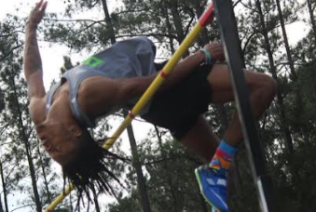
Maurice Thomas

Slide 21
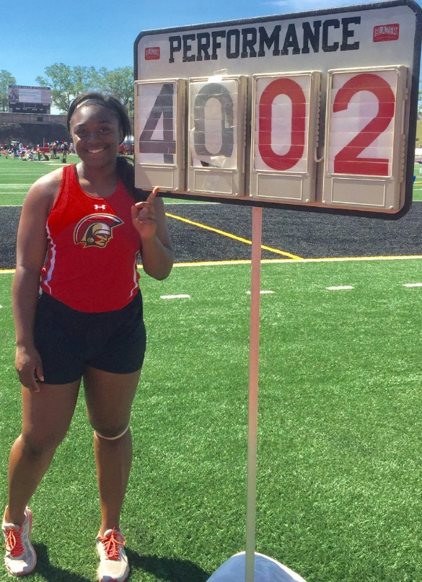
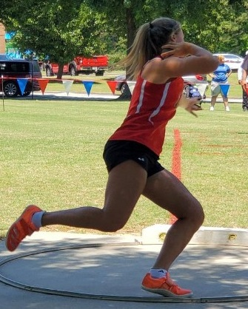
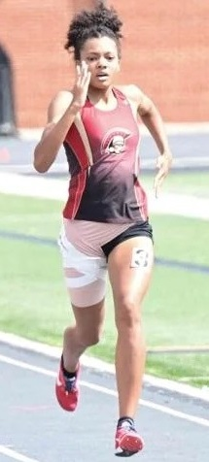
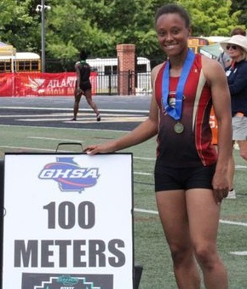
Autumn Clark
Alana Thomas
Morgan Collins
Nia Wilson

Slide 22
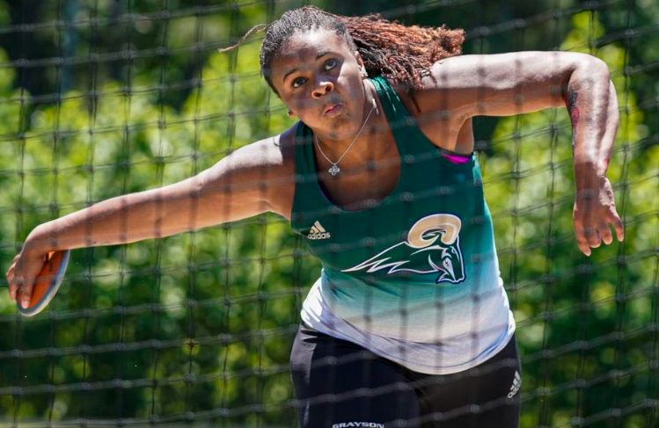
Kameryn Hannon

Slide 24
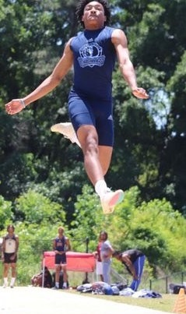
Michael Tatnall

Slide 25
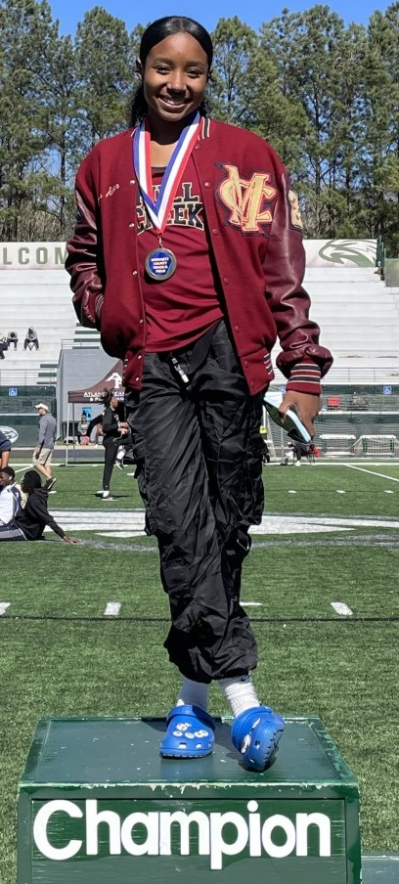
Madison Aiken

Slide 26
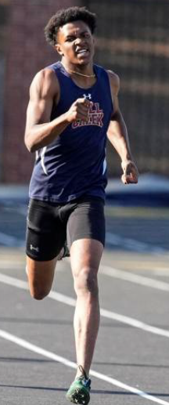
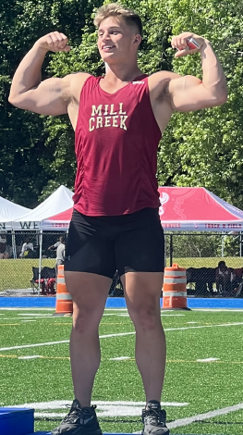
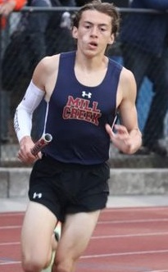
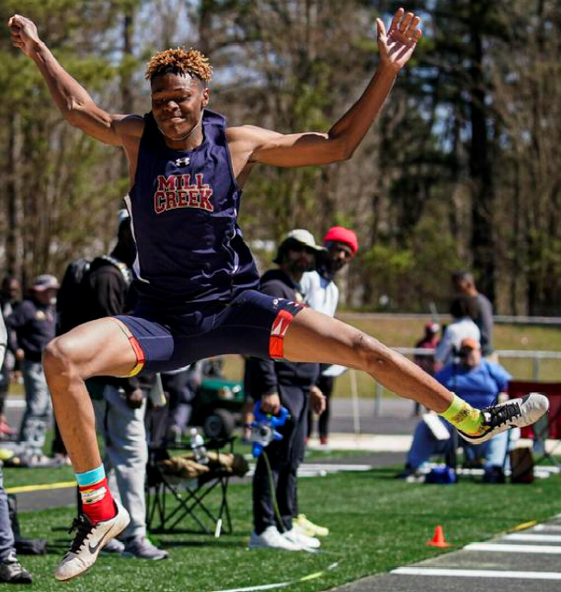
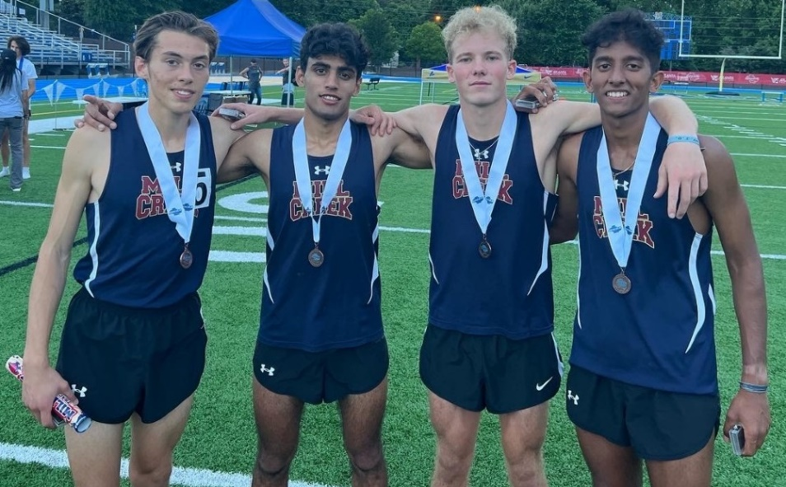
Boys 4x800m (Shazeb Rashid, Ethan Nordman, Luke Kalarickal, Jake Peters), Joseph Alexander, Jaiden Patterson, Brandon Akers

Slide 27
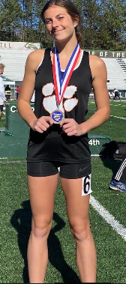
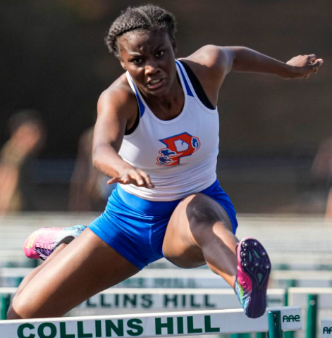
Carson Moore
Emma Geaney

Slide 28
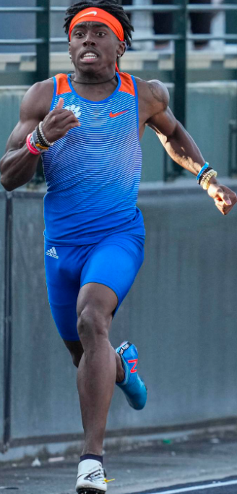
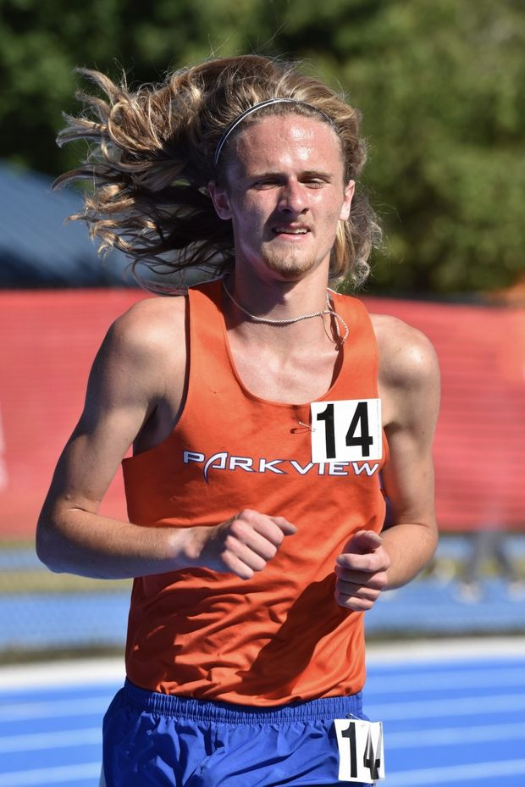
Caden Hall
Eric Pullum, Jr.

Slide 29
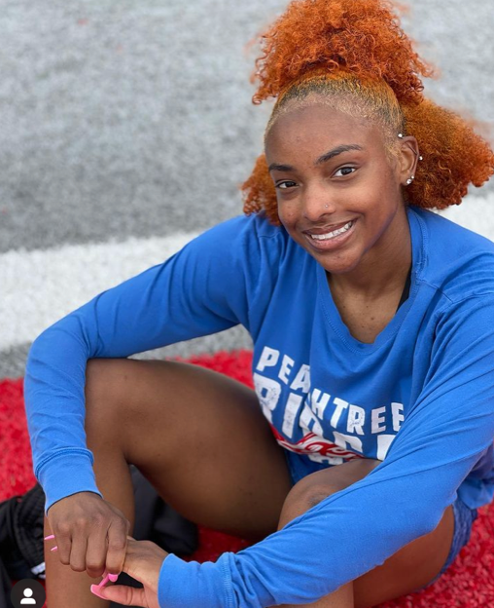
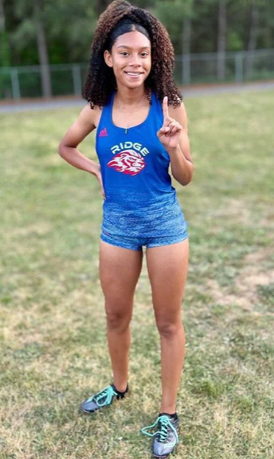
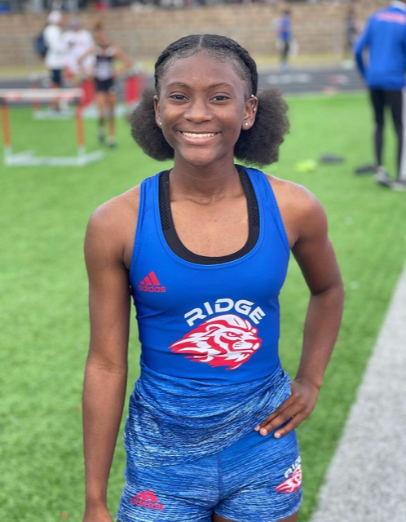
Ron-Niah Wright
Tamiia Fuller
Sydney Augmon

Slide 30
Boys 4x100m (Jordan Ghant, Tyre Tatum, AJ Bonds, Jeremiah Colbert)

Slide 31
Ellison Chadwick

Slide 32
Boys 4x400m (Christion Barker, Eric Barker, Parris Hawkins, Sanaljay Bentley) Bryce Southerland, Nathan Solomon

Slide 33
Alex Shepard

Slide 34
Imani Washington
Sade Ojanuga

Slide 35
Congratulations to our 2022 Gwinnett County Girls Track Runner of the Year, Tamiia Fuller of Peachtree Ridge!

Slide 36
Congratulations to our 2022 Gwinnett County Girls Field Athlete of the Year, Sha’Nyah Woolery of Berkmar!

Slide 37
Congratulations to our 2022 Gwinnett County Boys Track Runner of the Year, Nathan Solomon of Shiloh!

Slide 38
Congratulations to our 2022 Gwinnett County Boys Field Athlete of the Year, Langston Jones of Brookwood!

Slide 39
Congratulations to our 2022 Gwinnett County Girls Track & Field Coach of the Year,
Shawn Nix of Peachtree Ridge!

Slide 40
Congratulations to our 2022 Gwinnett County Track & Field Boys Coach of the Year, Devin Jones of Shiloh!

Slide 41
Thank you for a great 2022 Track & Field season for Gwinnett County Schools! We hope you enjoy a little break, and we’ll see you soon!

